Slide 1
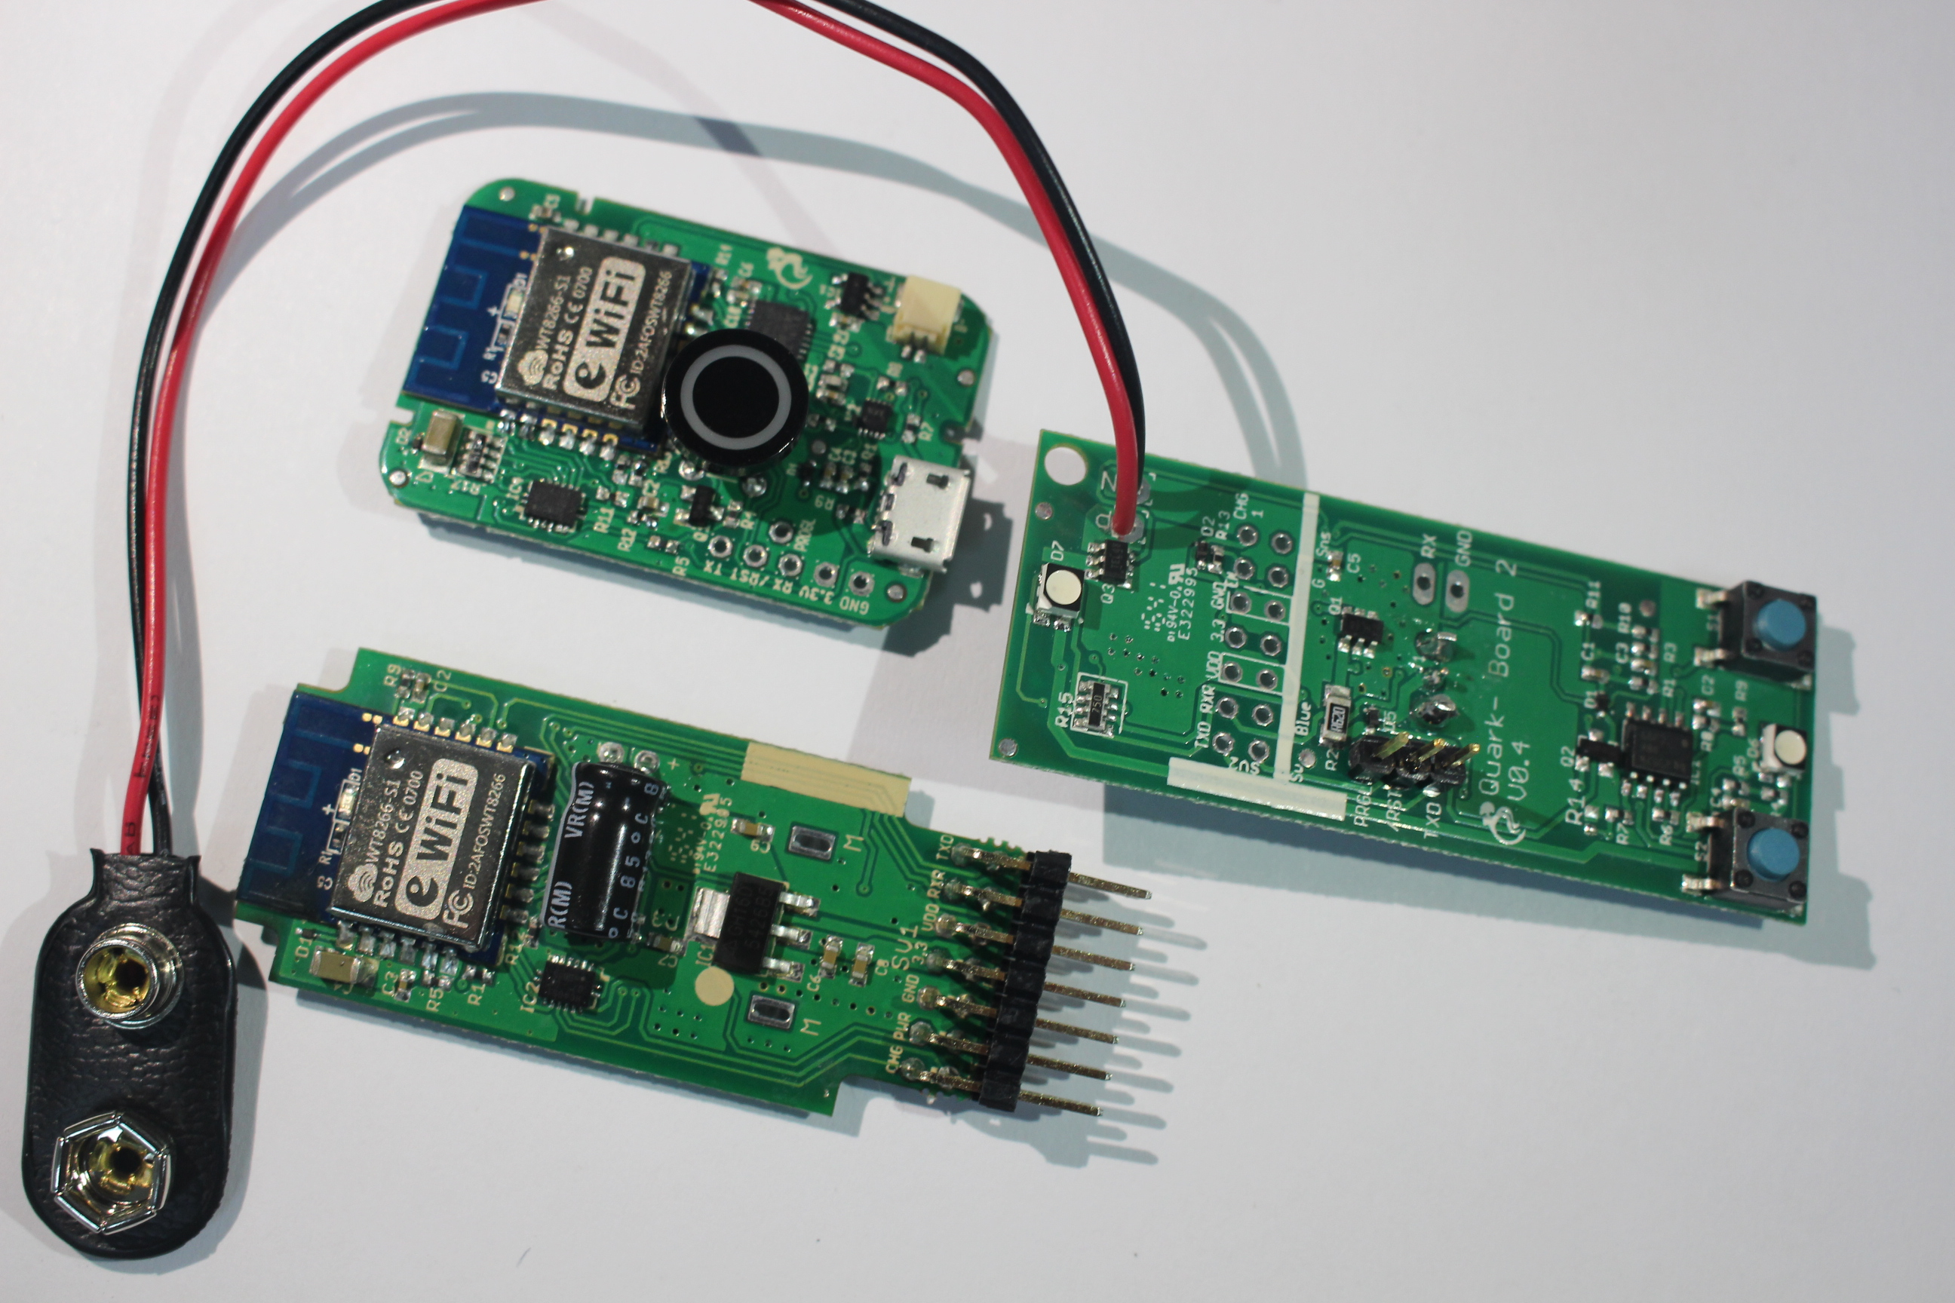
Switch Cap Should be sent separately
Do Not Install
Should be assembled from back

Slide 2
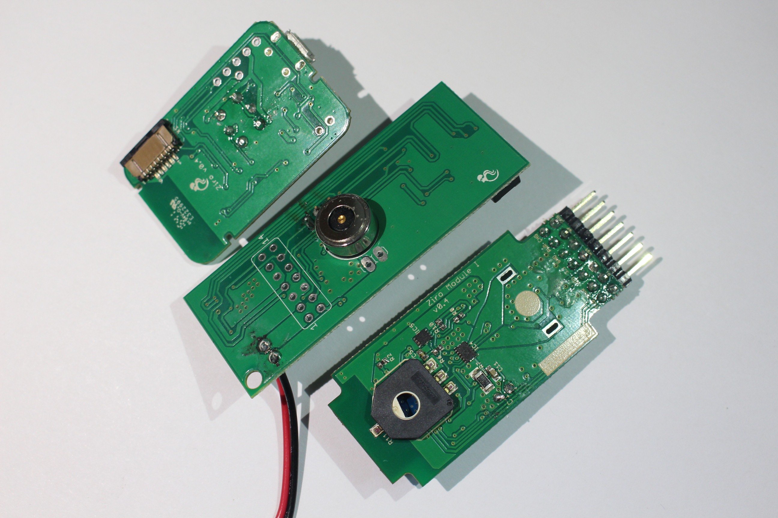
Could you make this flush to the board?
Kindly send mating connector
separately
Flux Residue Cleaning

